Slide 1
Artificial intelligence and its impact on employment in the future
What is AI?
What are its Benefits?
What are its risks?
AI Application in different sectors
Kapil, Adam Elsbury, James, James Fuller

Slide 2
What is Artificial Intelligence?
Artificial intelligence is the simulation of human intelligence processes by machines, especially computer systems. These processes include learning (the acquisition of information and rules for using the information), reasoning (using the rules to reach approximate or definite conclusions), and self-correction.
The term AI was coined in 1956 by an American called scientist John McCarthy.
AI known today is known as narrow AI or weak AI. The reason being it is only designed to perform narrow tasks ( e.g. only driving cars, only facial recognition or only internet searches).

Slide 3
What are the benefits of AI?
Dealing with mundane tasks – It has potential to complete the mundane task through intricate automation that will increase productivity.
Faster decisions – Tasks performed by AI will help with a faster results and carry out actions quicker.
Avoiding errors – With artificial intelligence, data could be processed error-free, no matter how big the dataset might be.
Taking the risk on behalf of humans – AI can be used to perform task such as

Slide 4
What are the risks of AI?
Job loss – One of the main area of concern with AI are the job losses. It has already displaced many low skilled jobs and it is likely to even further extended to new level.
Distribution of power – Carries the risk of taking control away from humans. Nations that are in possessions of AI could theoretically kills humans without needing to pull the trigger.
Lack of judgement calls – With humans you are able to take on unique circumstances and judgment calls into account when the decisions are being made something which AI may never be able to do.

Slide 5
is AI really taking over jobs?
One recent example of AI causing a job loss to humans happened to be in a company called Fukoko Mutual Life Insurance in Japan. In January 2017, 34 of its employees were dismissed from their jobs because the insurer had installed a new artificial intelligence system that could read medical certificates, gather data on hospital stays and surgeries, and, in the process, save the company an estimated 140 million Yen per year in salary costs.
It has been predicted that over 1.5 million jobs will be lost to AI in the next five years alone. This is because AI are becoming more and more advance with the new technologies that are being discovered.

Slide 7
“What determines vulnerability to automation is not so much whether the work concerned is manual or white-collar but whether or not it is routine”
Michael Morgenstern (2016)

Slide 8
AI impact on employment – Clothing industry
19th Century: Amount of cloth a single manual weaver could produce in America (per hour) was increased 50x by automation
Automation reduced the cost of labour per yard of cloth by 98%
The cloth became cheaper to make, thus resulting in the cost to the consumer becoming lower and the increase in demand actually led to 4 times more jobs in the long run.
The Economist (2016)

Slide 9
AI impact on employment – automobile industry
Automation of the production of cars had a dramatic negative effect on horse related jobs. (Displacement effect)
New industries arose due to the increased number of cars on the roads leading to new industries around maintenance, and motel and fast food industries to cater for truck drivers and motorists. (Productivity effect)
The Economist (2016)

Slide 10
AI impact on employment – automobile industry
Extrapolation;
Short term, displacement has a large and immediate effect on the workforce with redundancies and hourly Rota cutbacks where the labour costs are reduced (compared to manual workers) due to automation.
Long term automation within an industry is shown to have a positive effect on the job market, but only once it has adapted to the “automotive shock”.

Slide 11
AI impact on employment – E-Commerce
The European commission indicates that the online sale of goods in the EU was increasing “at an average annual growth rate of 22 percent, surpassing €200 billion in 2014 and reaching a share of 7 percent of total retail sales”.
This is due to the automisation of the retail industry (where production goods are sent to be sold) resulting in lower maintenance and shipping costs for low and medium enterprise businesses.
Petropolous (2016)

Slide 12
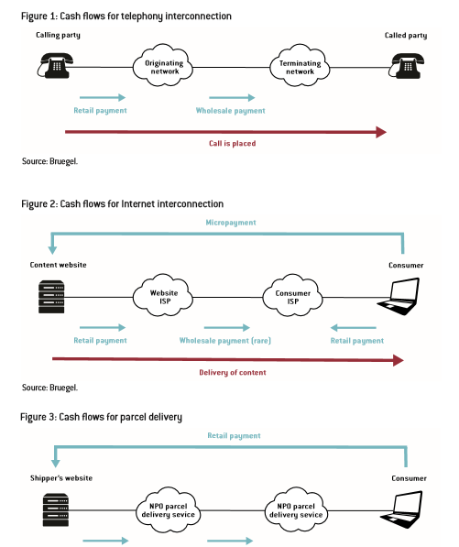
AI impact on employment E-Commerce
Reducing man power in telephone retail services and manual shipping has led to the growth of the E-Commerce platform where automation plays a major role in the industry.

Slide 13
AI impact on employment – E-Commerce
Extrapolation;
All the computerised automation within the E commerce platform has reduced the amount of man power needed for a small or medium enterprise business (especially in order and shipping departments).
The reduced cost of shipping products has meant the lower end/entry level has lowered, resulting in more SME businesses entering the market – leading to more goods being sold (Stimulating the economy).
Automation in the E commerce (online) world has made the industry explode and has now overtaken brick and mortar stores in terms of products purchased.

Slide 14
AI impact on employment – rates
The McKinsey Global Institute estimates that, compared with the Industrial Revolution of the late 18th and early 19th centuries, AI’s disruption of society is happening ten times faster and at 300 times the scale now. That means roughly 3000 times the impact.
International federation of Robotics;
Europe has introduced more instances of AI and robots than the US;
EU: 0.6 robots per 1000 workers (1990) to 2.6 robots per thousand workers (late 2000’s)
US: 0.4 robots per 1000 workers (1990) to 1.4 robots per thousand workers (late 2000’s)

Slide 15
AI impact on employment – rates
Extrapolation;
The authors conclude that one additional robot per thousand workers reduces the US employment-to-population ratio by about 0.18-0.34% and wages by 0.25-0.5%.
(Mckinsey 2016)

Slide 16
AI impact on employment – rates
If the spread of robots proceeds over the next two decades as expected by experts, such as Brynjolfsson and McAfee (2012) and Ford (2015), its aggregate implications for employment will be much larger. These books also warn that “white collar” jobs could be impacted just as much as “blue collar” ones.
Frey and Osborne (2013) predict that about 47% of total US employment is vulnerable to automation over the next 20 years. Primarily damaging low skill/low wage workers.

Slide 17
AI impact on employment – rates
Chui, Manyika and Miremadi (2015) estimate that 45% of work activities could be automated using already demonstrated technology in the US. The study also finds that even the highest paid occupations such as financial managers and CEOS have a significant portion of their job under threat from automation.
Extrapolation: Both low skilled, low paid jobs and high paid, higher skilled jobs are at risk contrary to beliefs held by scientists in the 80’s (who only stated low skilled jobs were at risk).

Slide 18
AI impact on employment – rates
If the spread of robots proceeds over the next two decades as expected by experts, such as Brynjolfsson and McAfee (2012) and Ford (2015), its aggregate implications for employment will be much larger. These books also warn that “white collar” jobs could be impacted just as much as “blue collar” ones.
Frey and Osborne (2013) predict that about 47% of total US employment is vulnerable to automation over the next 20 years. Primarily damaging low skill/low wage workers.

Slide 20
DRIVERLESS CARS & AI’S EFFECTS ON THE DRIVING INDUSTRY
Notes:
Googles self driving car prototype
'Self-driving technology might replace millions of driving jobs over the coming decade. In addition to possible unemployment, the transition will bring new challenges, such as rebuilding infrastructure, protecting vehicle cyber-security, and the adaptation of laws and regulations’ oxford and Yale paper

Slide 21
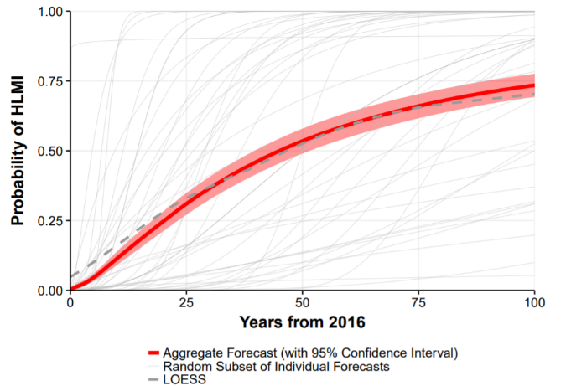
HLMI (High Level Machine Intelligence)
Figure ‘When Will AI Exceed Human Performance’ 352 of 1634 - 2016(Grace, Salvatier, Dafoe, Zhang, Evans, 2017 Oxford & Yale Universities)
Notes:
Large survey of 352 of 1634 contacted machine learning researchers on their beliefs about progress in AI. 30/05/2017. Nothing but opinions from academics/professionals in their field.

Slide 22
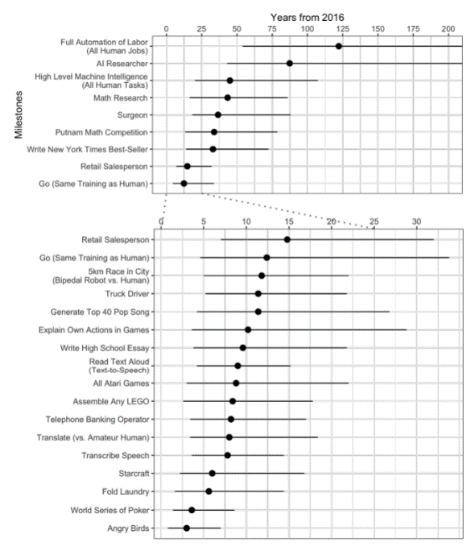
PREDICTED AI MILESTONES
‘When Will AI Exceed Human Performance’ (Grace, Salvatier, Dafoe, Zhang, Evans, 2017 Oxford & Yale Universities)
Notes:
Researchers predict AI will outperform humans in many activities in the next ten years, such as translating languages (by 2024), writing essays/reports (by 2026), driving a truck (by 2027), working in retail (by 2031), writing a bestselling book (by 2049), even working as a surgeon (by 2053). Researchers believe there is a 50% chance of AI outperforming humans in all tasks in 45 years and of automating all human jobs in 120 years

Slide 23
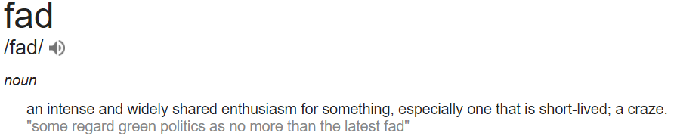
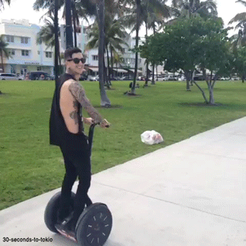

Fad?
Notes:
Is this a fad? Could driverless cars be receiving the same kind of publicity that the Segway saw… which is easily the most memorable failure to revolutionise personal transport in recent history
Ask audience

Slide 24
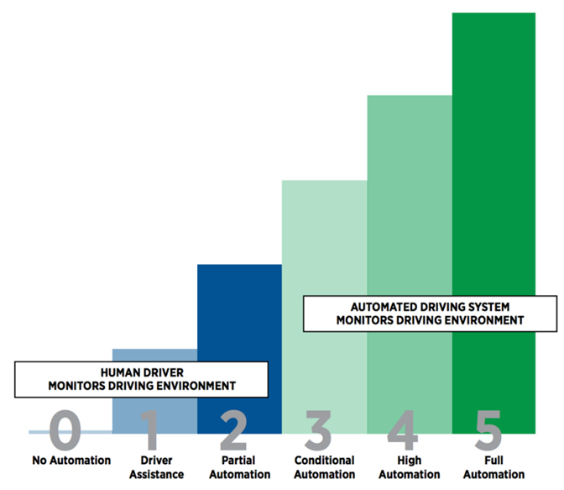
LAYERS OF AUTONOMY
Notes:
Different cars are capable of different levels of self-driving, and are often described by researchers on a scale of 0-5.
Level 0: All major systems are controlled by humans
Level 1: Cruise control or automatic braking may be controlled by the car.
Level 2: The car offers at least two simultaneous automated functions, like acceleration and steering, human required.
Level 3: The car can manage all safety-critical functions under certain conditions, but the driver is expected to take over when alerted
Level 4: The car is fully-autonomous in some driving scenarios
Level 5: The car is completely capable of self-driving in every situation

Slide 25
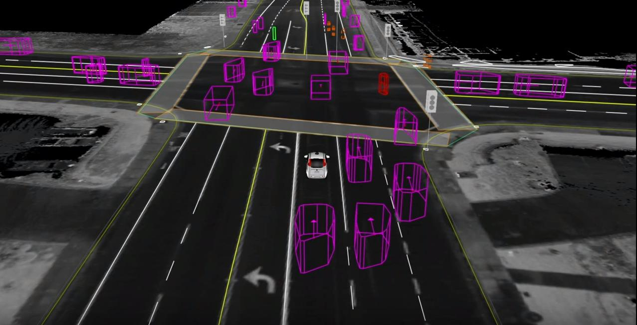
Notes:
Combines map and sensor data to compile what it sees in real time, Lidar (Light detection and radar)

Slide 27
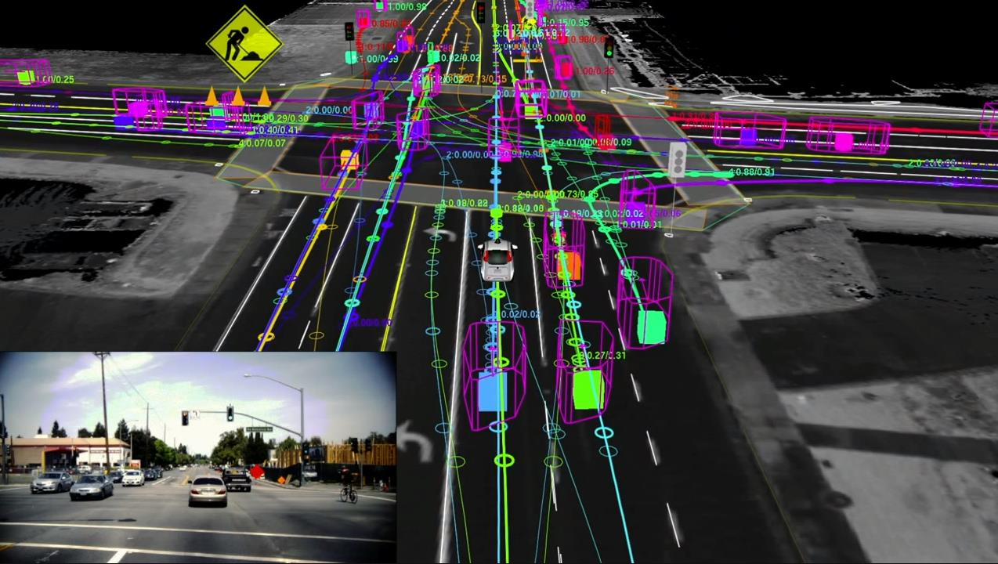
Notes:
Google car software imaging ted talks

Slide 28
Notes:
Millions of miles of simulation a day

Slide 29
SELF-DRIVING CAR PREDICTED DATES FOR AUTOMAKERS
General motors – Rumoured to have targets of self driving vehicles by 2018
Ford – Fully autonomous vehicle by 2021
Honda – Self driving on the highway by 2020
Toyota - Self driving on the highway by 2020
Renault Nissan – Autonomous cars in urban conditions 2020, Truly autonomous cars in 2025
Volvo – self driving on the highway by 2021
Hyundai – Highway by 2020, Urban by 2030
Daimler – Near to fully autonomous in the decade of 2020
Notes:
GM - In December, GM CEO Marry Barra wrote, “We expect to be the first high-volume auto manufacturer to build fully autonomous vehicles in a mass-production assembly plant.”

Slide 30
LOGISTICS AND HAULAGE
- Will be first to adopt driverless technologies due to increased productivity, efficiency, popularity.
- Complete business model transformation for the industry
- Legal boundaries & reformations
-Large savings through less labour, fuel efficiency (Platooning), less accidents (Reduced human error)
Notes:
https://venturebeat.com/2017/06/04/self-driving-car-timeline-for-11-top-automakers/
Morgan Stanley released a report in 2013 estimating conservative annual savings of $168 billion annually

Slide 31
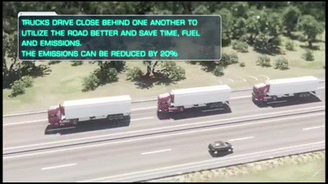
Notes:
https://www.youtube.com/watch?v=X3fF6m4ks1g – platooning video from scania

Slide 32
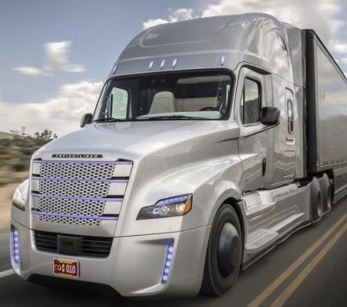
Daimler Freightliner inspiration
-Daimlers best-known autonomous vehicle project
- In collaboration with Nvidia (chip maker) and Bosch (parts manufacturing)
-First of it’s kind to be permitted to drive autonomously on Nevada's highways in 2015

Slide 33
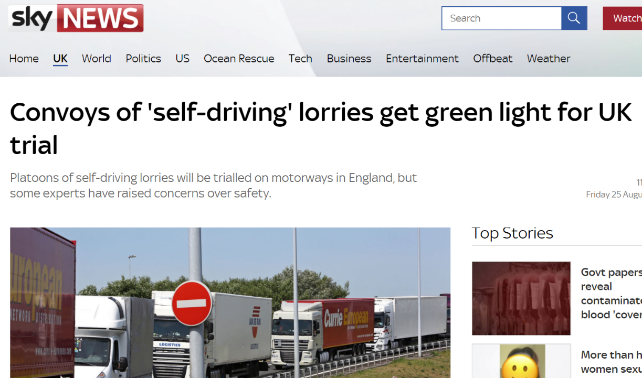
Notes:
The Government has committed £8.1m to finance trials of semi-autonomous "platooning" lorries.

Slide 34
UNEMPLOYMENT? (potential)
4 Million current workers in the US Driving Industry not including those for private hire work and 2 million in the UK
900,000 commercially licensed drivers will be needed in the US haulage industry in the next decade
Low interest from younger workers
New jobs created for maintaining vehicles, monitoring vehicles, maintaining and adapting software.
Autonomous ride sharing (more surplus to be spent elsewhere)
Automation has helped reduce back breaking / labour intensive / dangerous work in the past, creating higher paid machine operated jobs, why shouldn’t it here?

Slide 35
“due to our discovery of means of economising the use of labour outrunning the pace at which we can find new uses for labour” (Keynes, 1933).
Notes:
Essays in Persuasion (John Maynard Keynes) – a book that in his own words was “the collected croaking's of a Cassandra who could never influence the course of events in time.”
Hundreds of thousands of jobs in haulage / Private hire sector vehicles could be affected
What should we be doing to support the redundant workers left over through innovation and change
That can leave consumers with more surplus income to spend for other goods and services. Where might that income go, and what jobs might accompany it?

Slide 37

Artificial Vision
What is Artificial Vision?
Where and how Artificial Vision is being used
Demo of Artificial Vision
(recapguide 2001)

Slide 38
What is Artificial Vision?
(Bmva n.d) (Kaiser 2017)
Notes:
Computer vision is an area in AI. Humans use their eyes to see and their brain to interpret the signals received from the eyes to convert into vision. Whilst computers don’t have these biological systems, artificial vision replicates this function by giving a computer the ability to understand the world around it through image based input which is then processed (Bmva n.d)
These image inputs can come from many types of device: such as Cameras, FLIR imagery , 3D scanners.
The goal of Artificial vision is for the computer to understand the world using visual signals, and make decisions on the output; just like humans do (Kaiser 2017)

Slide 39

Where is Artificial Vision being used?
ANPR Cameras (Automatic Number Plate Recognition)
Indexing image and text
Facial recognition
ORC (Optical Character Recognition)
Object recognition
Landmark recognition
People tracking
Driver Assistance
(ventureradar 2017)(gov uk 2017)(Google Dev n.d)
(Google Cloud 2015)
Notes:
There are many applications that use Artificial vision as a data input. From ANPR cameras that scan number plates of cars to driving assistance that tack the movement of cars around us (ventureradar 2017)
Facial recognition is increasingly being used in biometric passports which were introduced in 2010 (gov uk 2017)
Landmark, object recognition is currently being used to index photos so that they are searchable with keywords associated with objects or places that might be present in the photos. (Google Dev n.d)

Slide 40
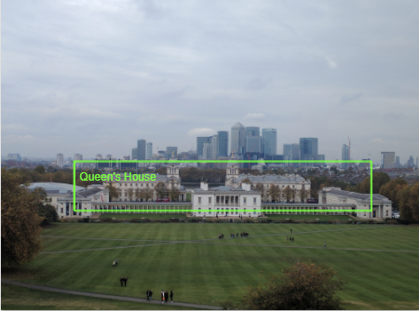
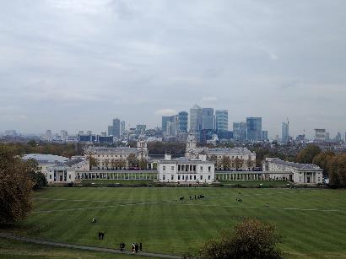
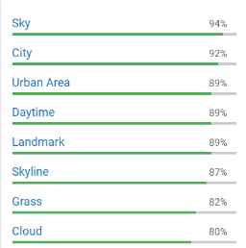
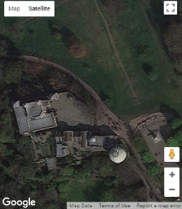
Landmarks Recognition
Google Vision API
Images of a known Landmark
Google Vision API
Notes:
We can see Computer vision in action. I took this photo using my digital camera, removed all associated metadata and then uploaded it to Google Cloud platform Vision API. A few seconds later the Google Cloud has analysed the photo, given the approximate location (which is almost right) and some further information about what else is in the photo.

Slide 41
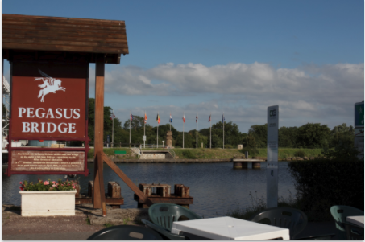

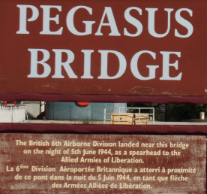


OCR (Optical Character Recognition)
Google Vision API
Google Vision API
Notes:
We can also use the same API to read text in images. The Computer vision did a very good job at reading the text on the sign in both English and French.
With ORC we can also solve those annoying Captcha on web forms which are sometimes impossible to read.

Slide 42
References
BMVA, n.d. What is computer vision? [viewed date 17th October 2017]. Available from: http://www.bmva.org/visionoverview
GOOGLE CLOUD, 2017. What is Computer Vision? [viewed date 18th October 2017]. Available from: https://hayo.io/computer-vision
GOOGLE DEV, 2017. What is Computer Vision? [viewed date 18th October 2017]. Available from: http://blog.ventureradar.com/2015/10/21/top-10-innovative-companies-in-computer-vision/
GOV UK , 2017. Biometric passports [viewed date 18th October 2017]. Available from: https://www.gov.uk/government/publications/biometric-passports-and-passport-readers/biometric-passports-and-passport-readers
KAISER , n.d. Mobile Vision [viewed date 18th October 2017]. Available from: https://developers.google.com/vision/
RECAPGUIDE , 2001. Ultrahouse 3000 [digital image] [viewed date 17th October 2017]. Available from: http://recapguide.com/recap/117/The-Simpsons/season-13/episode-1/
VEnNTURERADAR , 2015. Cloud vishion API [digital image][viewed date 17th October 2017]. Available from: https://cloud.google.com/vision/

Slide 43

Any Questions?

